Slide 1
FudgeMart Corporation Analysis
Data Warehouse Project
Aditi Pala
Bhavya Shah
Shubh Mody
Yashaswini Kulkarni

Slide 2
Project Overview
Create a Data Warehouse and Business Intelligence (BW/BI) program for FudgeMart, Inc.
Two subsidiaries, Fudgemart and FudgeFlix databases are merged to bring diverse data sources together.
Analyze the Sales business process across the FudgeMart, Inc based on time intervals, product categories etc.
Identify actionable insights after identifying the business trends which will improve the Sales across both the organizations.

Slide 3
FudgeMart and FudgeFlix
FudgeMart
Fudgemart is a fictitious online retailer akin to industry giants like Amazon and Walmart.
Its database houses a rich array of customers, products, and vendors.
Boasts familiar e-commerce business processes, mirroring those of prominent online retailers.
FudgeFlix
Fudgeflix, another subsidiary, offers DVD-by-mail and video-on-demand services.
Similar to Amazon Instant Video or Netflix, its database comprises accounts, subscriptions, and video titles.
Features encompass aspects unique to online video streaming services.

Slide 4
Business Questions
Top 5 Revenue Generators: Discover the top five products that have showcased exceptional sales performance, driving substantial revenue.
Sales Trends Over 4 Years: Conduct a comprehensive analysis of sales data spanning four years, spanning across six distinct product categories, unveiling patterns and trends that have emerged over time.
Granular Sales Insights: Delve into the intricate sales dynamics by meticulously examining product performances across varied temporal scales – annually, monthly, and quarterly – encompassing both FudgeFlix and FudgeMart offerings.
Apex and Abyss of Sales Across US States: Identify the five highest-performing and five lowest-performing US states, unveiling the geographical impact on sales figures.
Order Trends over 4 years:

Slide 5
Project Flow
FudgeFlix
Staging
Sales Data
ETL
FudgeMart
Merging Fudgemart and FudgeFlix using ETL to create Sales Data Mart

Slide 6
Mapping Sales Data
Sales Data | FudgeMart | FudgeFlix
Product | Products | Plans
Customer | Customer | Accounts
Date | Order Date | Order Date
Sales | Orders | AccountBilling

Slide 7
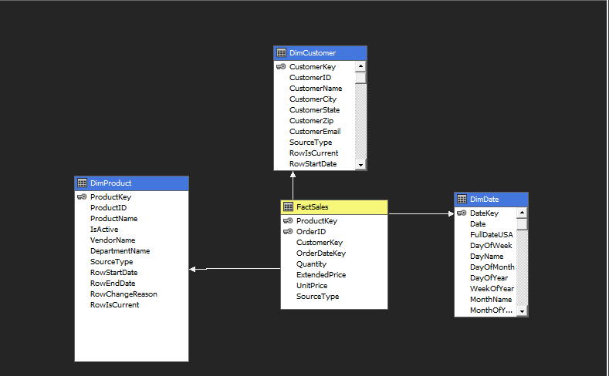
Star Schema

Slide 8
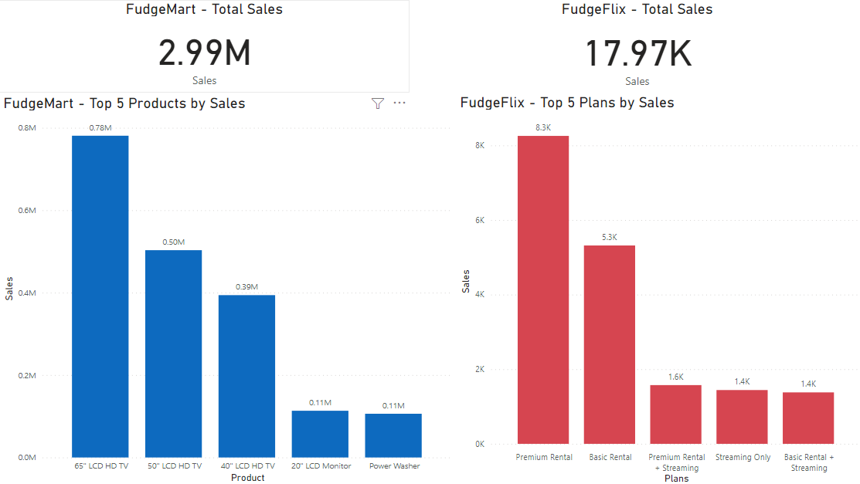
Top 5 Products By Sales - FudgeMart & FudgeFlix

Slide 9
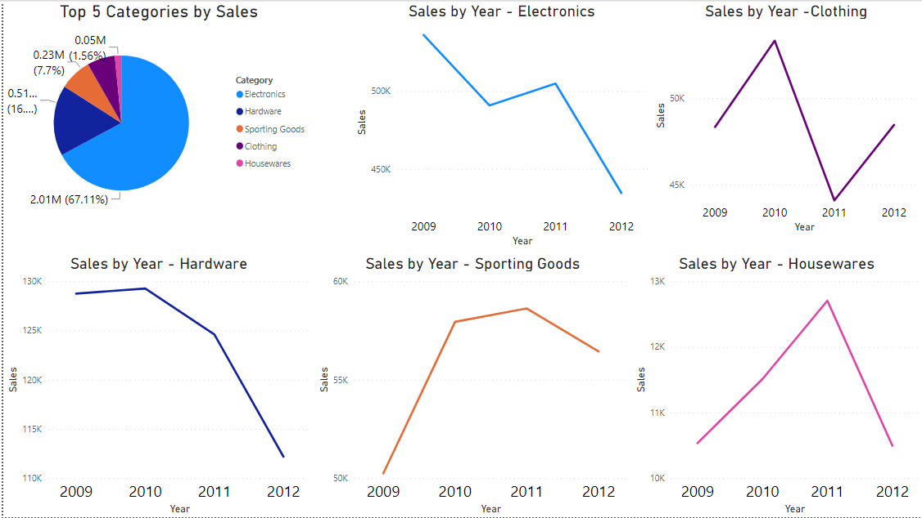
FudgeMart - Sales Analysis across Categories

Slide 10
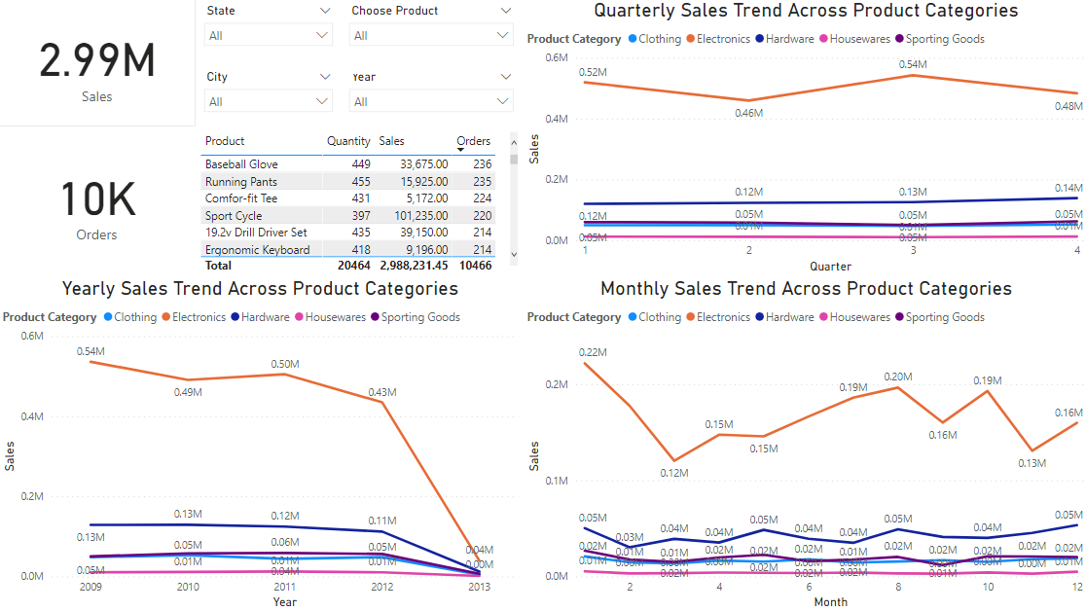
FudgeMart Sales Trends

Slide 11
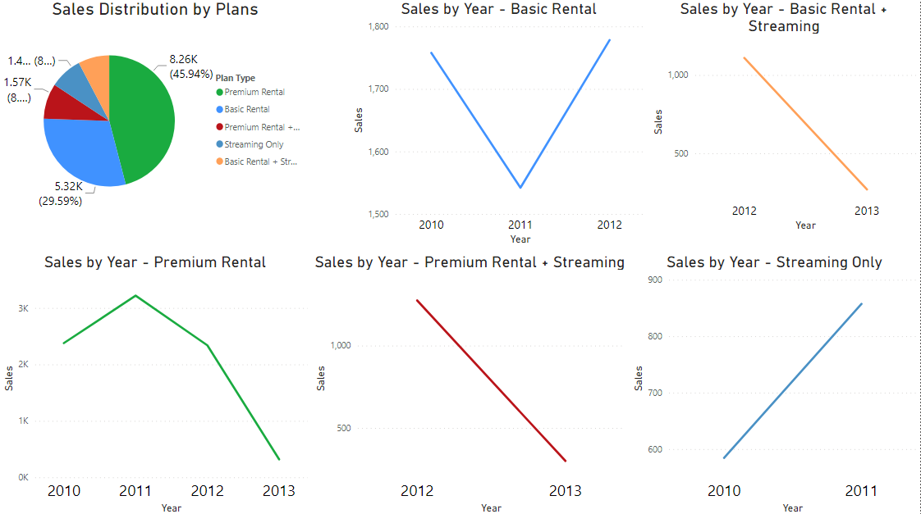
FudgeFlix - Sales Analysis across Plans

Slide 12
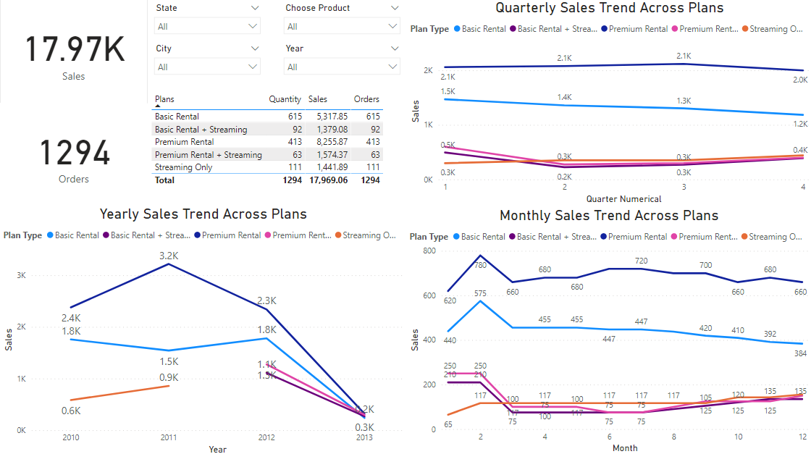
FudgeFlix Sales Trends

Slide 13
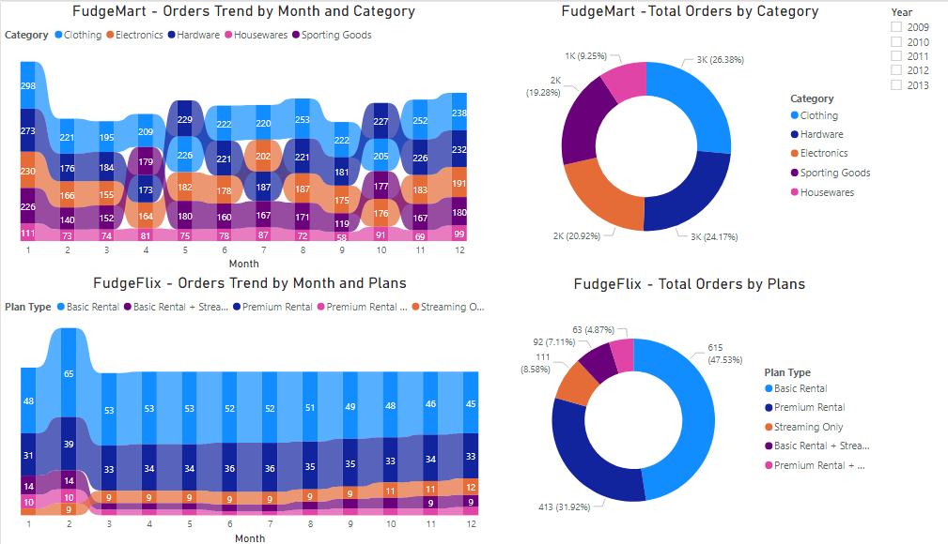
Order Trends - FudgeMart and FudgeFlix

Slide 14
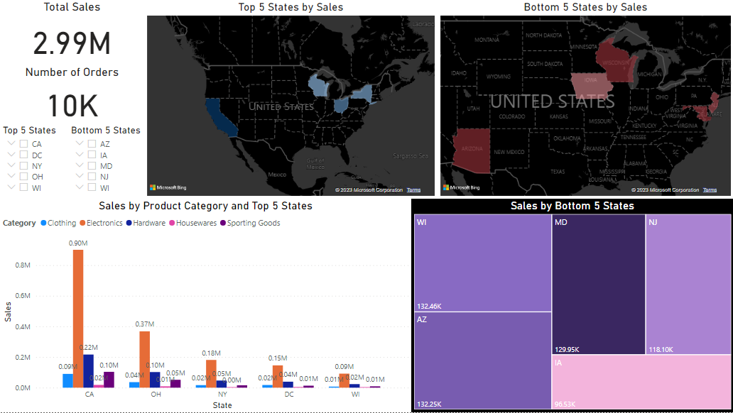
FudgeMart - Sales by States

Slide 15
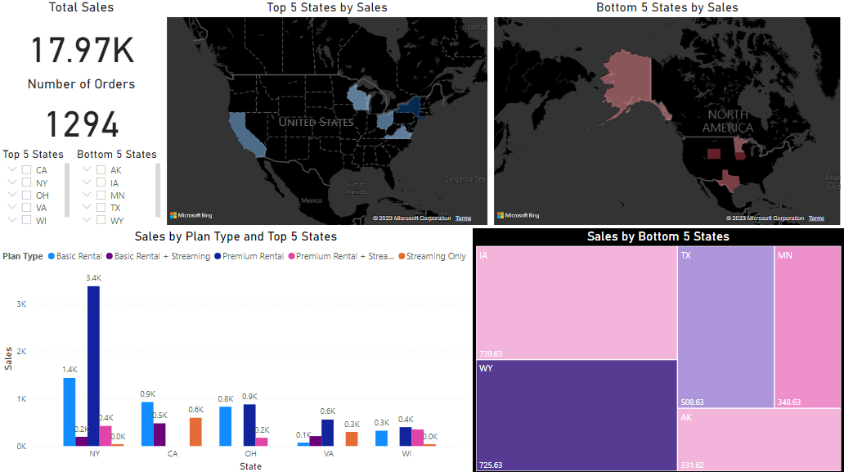
FudgeFlix - Sales by States

Slide 16
Recommendations
Fudgemart strategically focuses on securing exclusive electronics distribution agreements/contracts to ensure sole availability through their retail platform, thereby enhancing sales and maintaining high standards of customer service.
Revitalize the premium plan with time-limited 2-month offers; enhance basic plan features and marketing to attract a broader premium user base, fortifying Fudgeflix's expansion.
For Fudgemart: Implement targeted marketing in states with lower sales (WI, AZ, IA, MD, NJ) to boost brand awareness and sales. Customize messaging for local preferences.
For Fudgeflix: Boost subscriptions by providing exclusive content releases in low-sales regions(IA,TX,WY,AK,MN). Also, explore region-specific content or promotions for better local engagement.
Carefully curate the housewares product assortment based on market research and customer feedback. Prioritize houseware items that align with current trends and customer preferences.
Craft compelling campaigns from recurring sales dips in the third month featuring special offers, exclusive content for strategic seasonal initiatives. This is to effectively counter the decline and uphold strong customer engagement (like St.Patricks Day or start of spring)

Slide 17
Thank You

